Slide 1

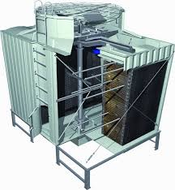
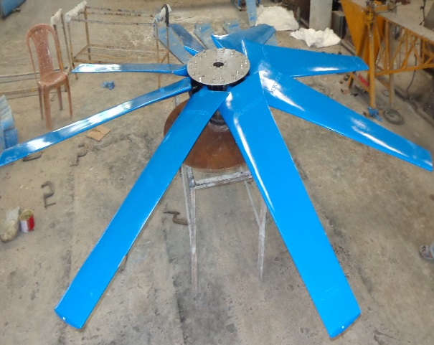
WELCOME
Aerotech Energy Pvt Ltd

Slide 2
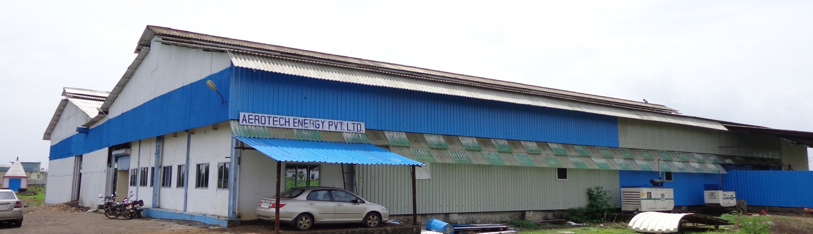
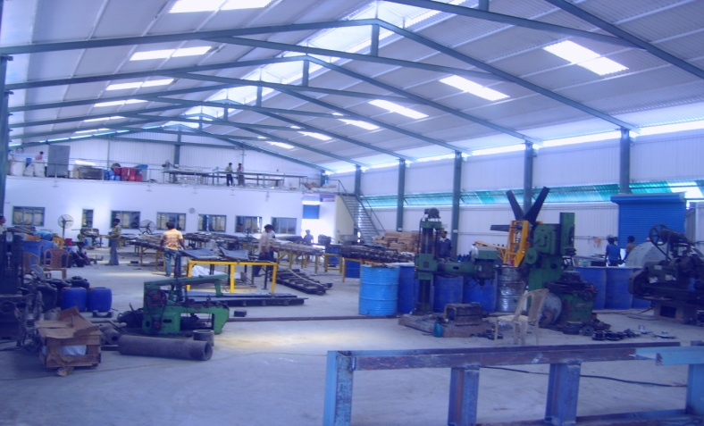
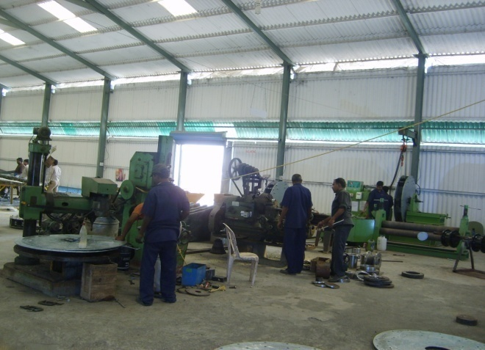
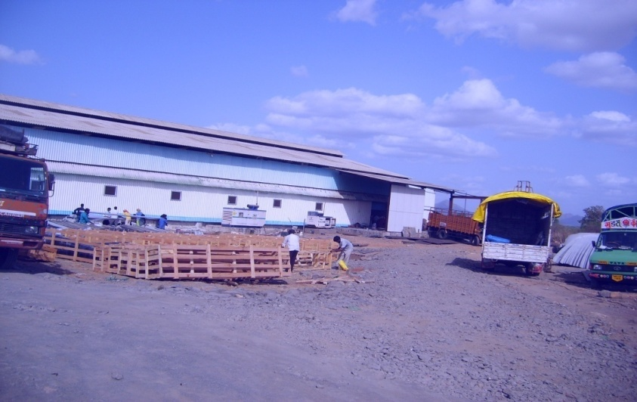
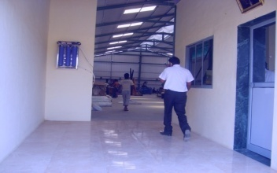
The Company has been incorporated and commenced manufacturing activities since 1996

Slide 3

Our Vision
Provide Consistent High Thermal Performance and Trouble Free Durable Cooling Towers.

Slide 4

Aerotech Supply

Slide 5
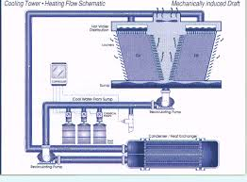
The Cooling Towers
A number of parameters describe the performance of a cooling tower.
Range is the temperature difference between the hot water entering the cooling tower and the cold water leaving.
The range is virtually identical with the condenser rise.
Note that the range is not determined by performance of the tower, but is determined by the heat loading.

Slide 6
Cooling Tower Terminology
A Tower cools 1,000 GPM from 45 ºC to 32 ºC at 28 ºC wet bulb temperature and operates at 3 cycles of concentration. Calculate Range, Approach, Heat Rejection, Drift Loss, Evaporation Rate, Bleed Rate and Make-up water requirements.
1. Range: (HWT – CWT) = 45 - 32 = 13 ºC
2. Approach: (CWT – WBT) = 32 - 28 = 4ºC
3. Heat Rejection: (Flow _{GPM} X Range _{ºF} X 500) = 1,000 x 10 x 500 = 5,000,000 btu’s/hr = 5,000 MBH)
4. Typical Drift Loss: (0.002% X Flow Rate) = 0.00002 X 1,000 = 0.02 GPM
5. Evaporation Rate: (Flow _{GPM} X Range _{ºF} / 1,000) = 1,000 X 10 / 1,000 = 10 GPM
6. Bleed Rate: (Evaporation Rate _{GPM} / (Cycles-1) = 10 / (3-1) = 5 GPM
7. Make-up Water Requirement: (Evaporation Rate _{GPM} X [Cycles/(Cycles-1)] ) = 10 x 3/2 = 15 GPM

Slide 7

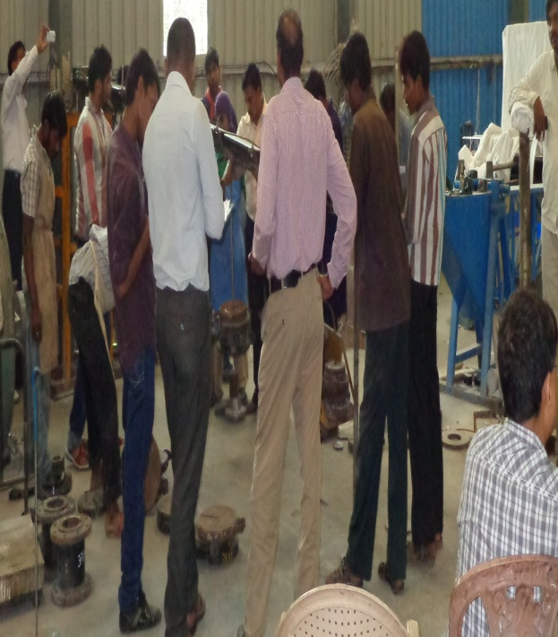
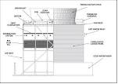
Our Strength
A team of Engineers Having more than 2 Decades of experience in Process Cooling Towers of Various Industry like Steel, Fertilizer, Power, Cement, Sugar, Pharmaceutical etc. Under the Guidance of experts having more than 3 Decades of all round experience from Concept to Commissioning of all types of Cooling Towers

Slide 8
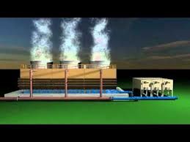
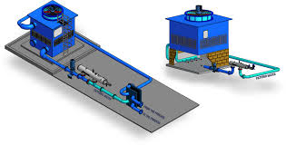
What We Do
1) Designing, Manufacturing, Supply, erection and Commission of Cooling Tower in RCC, Treated Timber, Pultruded FRP and Moduled FRP (Small Package Cooling Towers)
2) Re-design existing Cooling Tower for enhancement of Cooling Performance and Reduction of Operating Power Consumption with a view of Low maintenance
3) Under Performing Cooling Towers are inspected and identify the problems with thoroughly inspection and We proposed appropriate solution with redesigning to enhancing the required performance of Cooling Towers

Slide 9
Our Credibility
The Company is Established about 2 Decades back and have Presence in all over India, East Asian Countries, Gulf and Africa. Having started with the Manufacturing of Energy Efficient FRP Hollow Blade Fan Assembly, Now We are into a Complete Cooling Tower Company & ACC, ACHE.
We offer Service of Design, Manufacturing, Supply , Erection, Commissioning of Cooling Tower and After Sales Service,
We repair & Maintenances of Cooling Tower in all type & Make of Cooling Tower.

Slide 10
The Assignment (Sample Case Study)
Performance Improvement
Client : ESSAR POWER Ltd. Jamnagar
Capacity : 2 x600 MW power plant
Water : See Water
Number of CT : 4 x 12 Cell
Required Approach : 5 Deg C

Slide 11
Cooling Tower Designed for
Water Qty : 3500 CMH per Cell
Designed HWT: 45 Deg C
Designed CWT: 32 Deg C
WBT : 28 Deg C
Approach : 4 Deg C
Fill : C19 Vertical Offset Flute (Film)
Fan : 30 ft 8 Blade Assy
Motor Power : 130 kW

Slide 12
OBSERVATION 1
Required Improper Distribution System.­
Existing Distribution system has 256 nozzle for an area of 2304 sq. ft. each nozzle is covering an area of 9 sq. ft. Physical observation at sight shows considerable plan area is starving without water. Since the PVC fill pack has vertical offset flute, heat transfer area unused is very high. Moving type of sprinkler on the nozzle is jammed and breaking in many nozzle. This adds to the problem of poor water distribution. Once the sprinkler stops moving, the water distribution concentrates at one point.
Modified: Proper distribution on plan area will ensure complete coverage of water distribution throughout the fillpack area. In proposed distribution system, stationary nozzles without any moving parts are used. These nozzles is four stage gravity flow, non-clogging type and ensures free flow of water even with high TDS level. This four stage nozzle is capable to covers an area of 9 sq. ft with out starving, hence number of nozzles remaining same, resulted no need to replace of existing distribution system. Modification and location of Nozzles is shown in the enclosed drawing.

Slide 13
OBSERVATION 2
Required Increase the Fan Air Flow and Additional Diagonal
Structure Vibration increases while Fan Blade angle is increased, This is due to natural frequency of vibration of Fan Blades at higher load on blade, which transferring on inadequate load distribution below gear box load bearing structure.
Changed the fan blades configuration to achieve required L/G ratio and too reduce the load on individual blade.
Additional FRP structure strengthening inadequate load bearing structure below gear box.

Slide 14
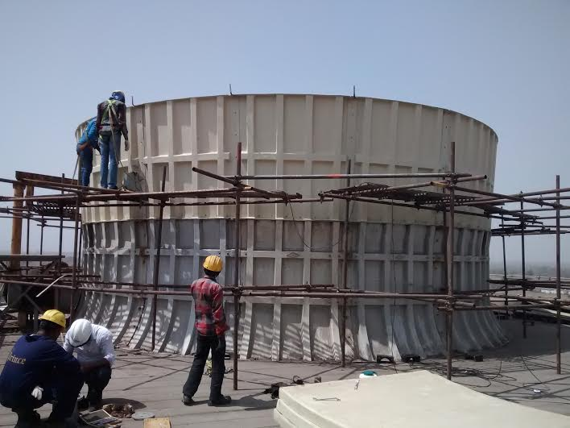
OBSERVAYION 3
Exhausted Air Re-circulation & Required Recovery Cone Fan Stack-
Recovery Cone Stack should be provided to improve Fan efficiency and reduce recirculation of Air. Drawing for Recovery Cone Fan Stack and Fan characteristic curve is enclosed herewith.

Slide 15
OBSERVATION 4
Clogging of Fillpack-
Corrugated fillapck tends to get clogged over a period of time, Collected dust in the inlet air is washed and mixed in the circulating water, Collected fine dust will be deposited in the corrugation points of PVC fillpack allow free water flow without restriction within the fill pack. This will reduce retention time between air & water, Combined effect of the same will be poor thermal performance of the Tower.
Periodic cleaning of fillpack is necessary to maintain steady return water temperature, Physical inspection of fillpack at site shows considerable clogging,
Cleaning of Fillpack is advised to improve Cooling Tower effectiveness.

Slide 16
OBSERVATION 5
5. Fill Pack Cleaning-
It is advisable to procure fillpack for 1 cell & Fill pack of 1 cell will be removed for cleaning and the new fillpack will be installed. The process of cleaning the fill pack can be carried out cell by cell after cleaning the fillpack removed from 1st cell. Majority of fillpack could be able to reuse. However exact quantity can be assessed only after physical inspection of dismantled fillpack.

Slide 17
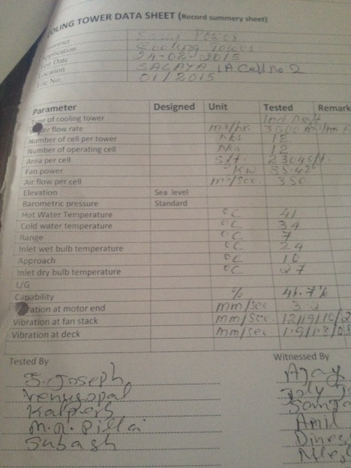
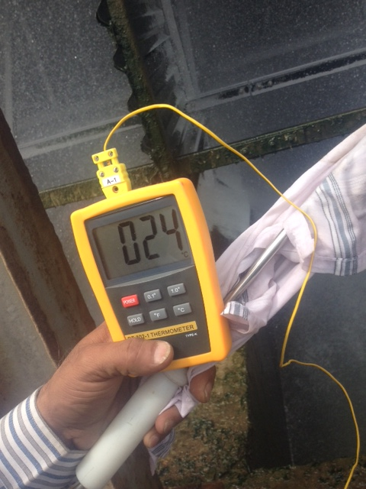
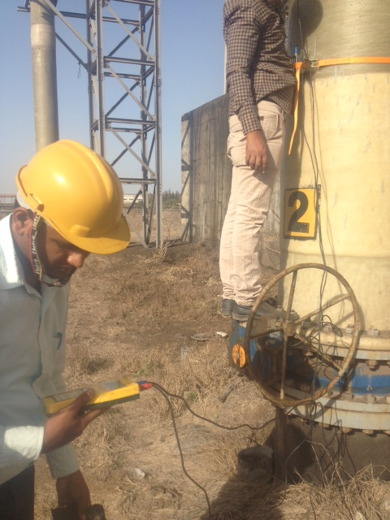
EXISTING CT TEST REPORT
Parameter | Designed | Unit | Tested | Remark
Type of cooling tower |  |  | Induced Draught
Water flow rate |  | CMH | 3500
Number of cell per tower |  | NOS | 12
Number of operating cell |  | NOS | 12
Area per cell |  | SFT | 2304
Fan power |  | Kw | 88.42
Air flow per cell |  | CMS | 350
Elevation | Sea level
Barometric pressure | Standard
Hot Water Temperature |  | C | 41
Cold water temperature |  | C | 34
Range |  | C | 7
Inlet wet bulb temperature |  | C | 24
Approach |  | C | 10
Inlet dry bulb temperature |  | C | 27
L/G
Capability |  | % | 41
Vibration at motor end |  | MM/S | 3.4
Vibration at fan stack |  | MM/S | 12
Vibration at deck |  | MM/S | 1.0

Slide 18
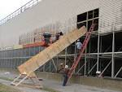


Aerotech Designed Proposal
Water Qty : 3500 CMH per Cell
Designed HWT: 45 Deg C
Designed CWT: 33.5 Deg C
WBT : 28.3 Deg C
Approach : 5.2 Deg C
Fill : Existing with cleaned
Fan : 30 ft 10 Blade Assy

Slide 19
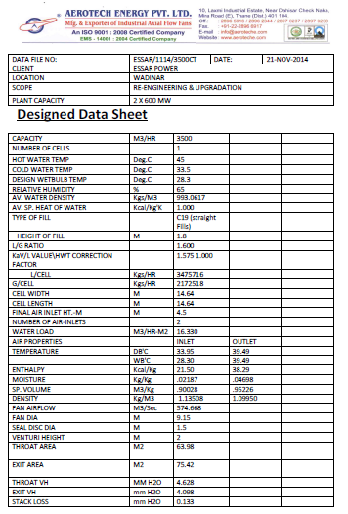
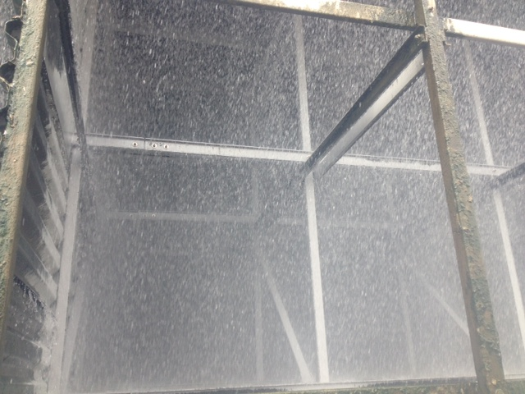
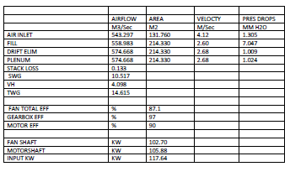
PROPOSSED DESIGNE DATA

Slide 20
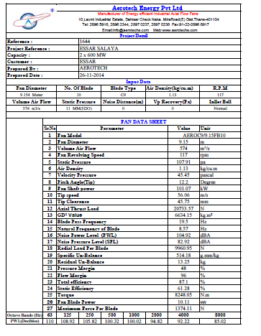
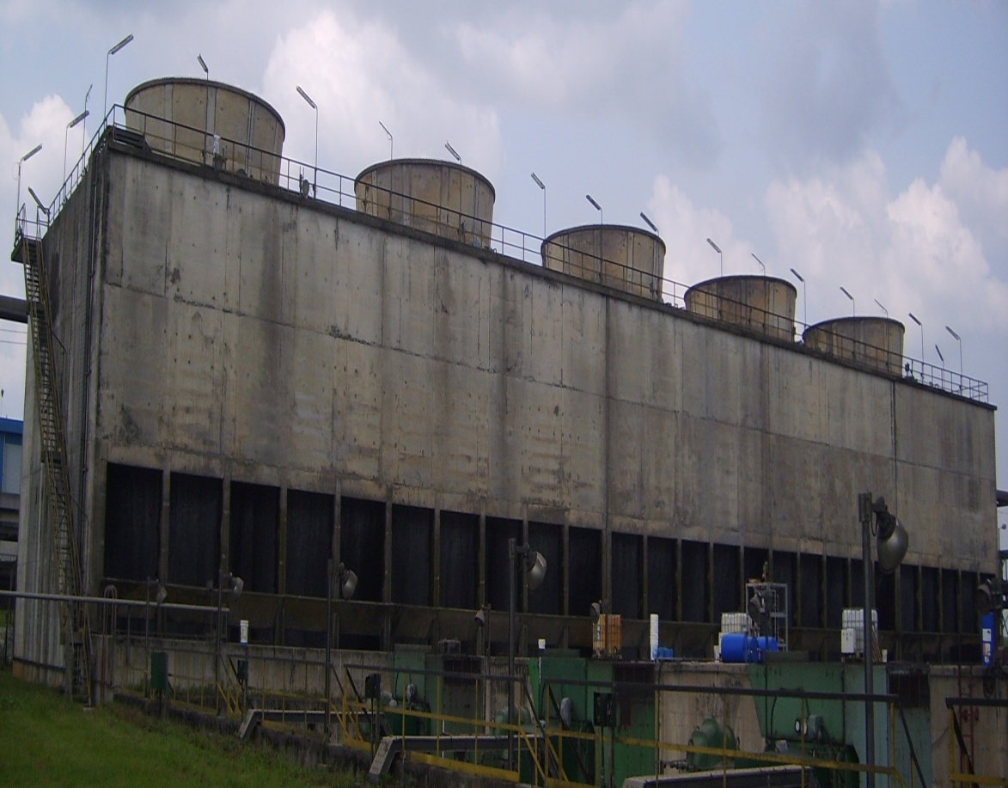
AIR SIDE DATA

Slide 21
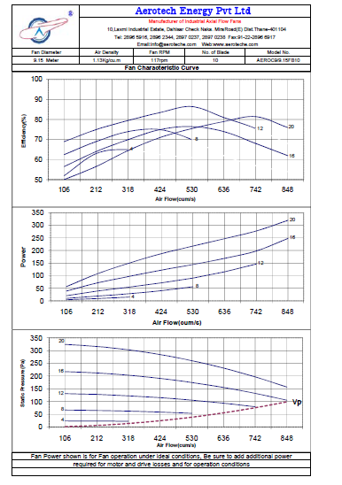
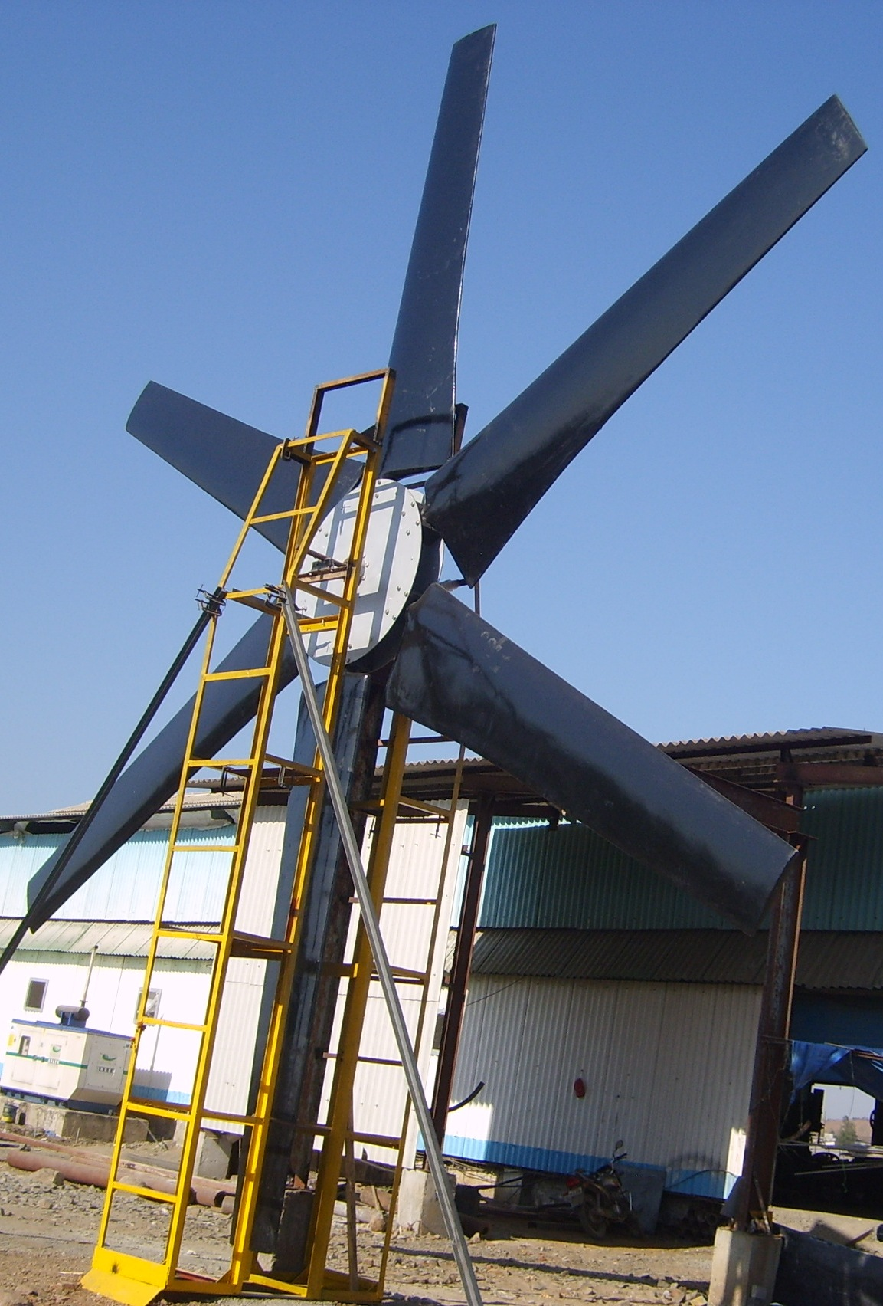
FAN CHARACTERISTIC CURVE

Slide 22
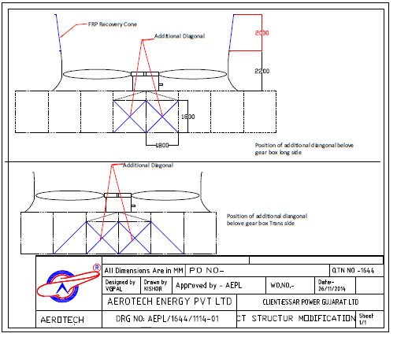
MODIFICATION ON FAN STACK & Diagonal

Slide 23
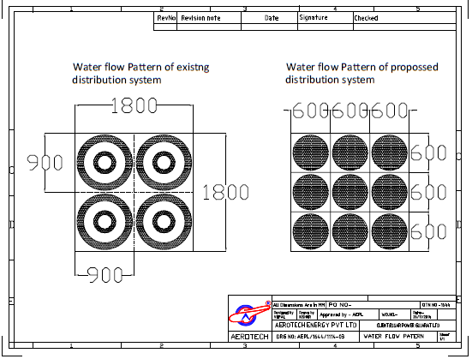
IMPROVMENTS WATER FLOW

Slide 24
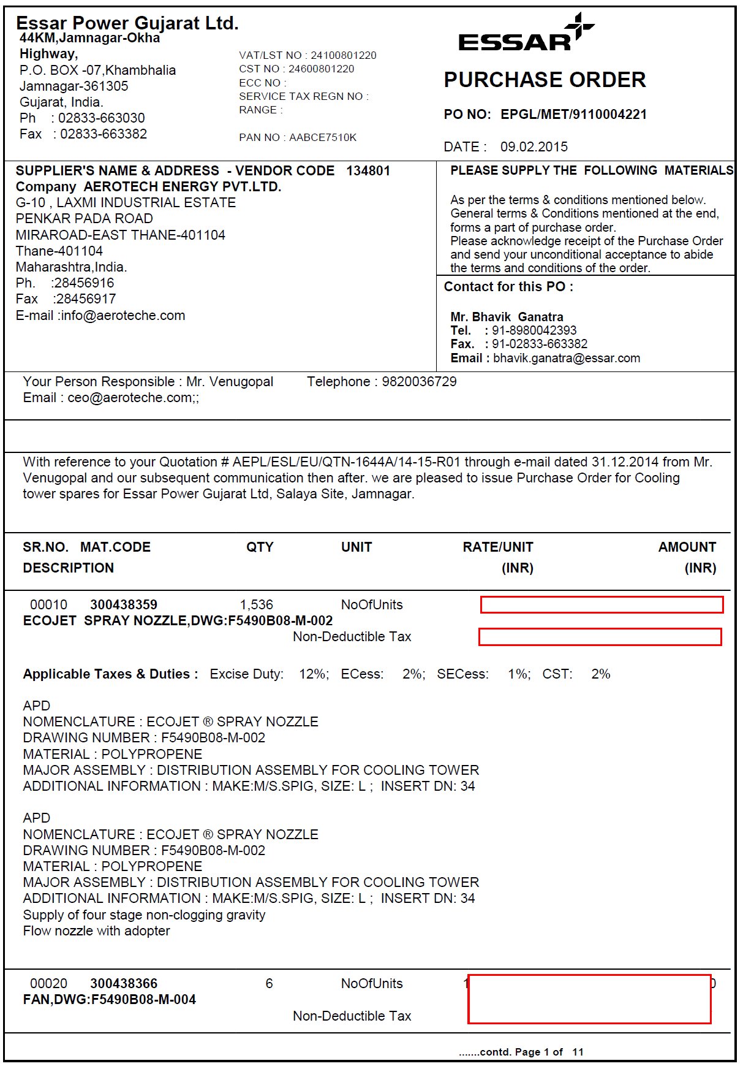
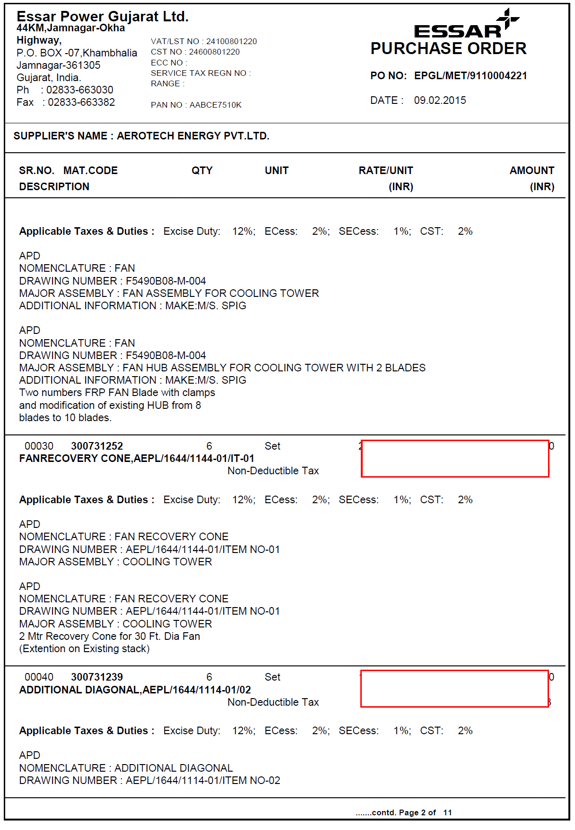
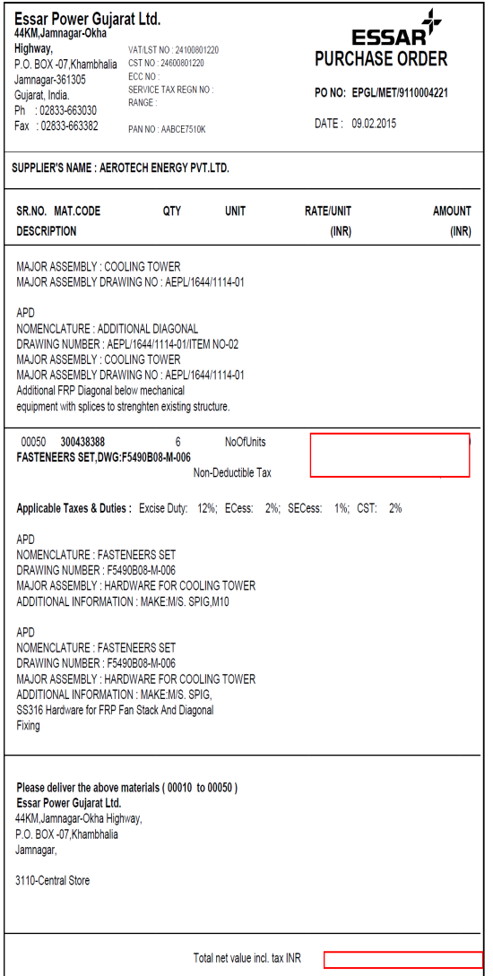
PURCHASE ORDER

Slide 25
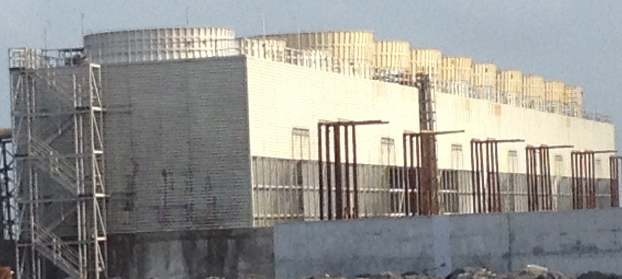
Fan stack Height Increased

Slide 26
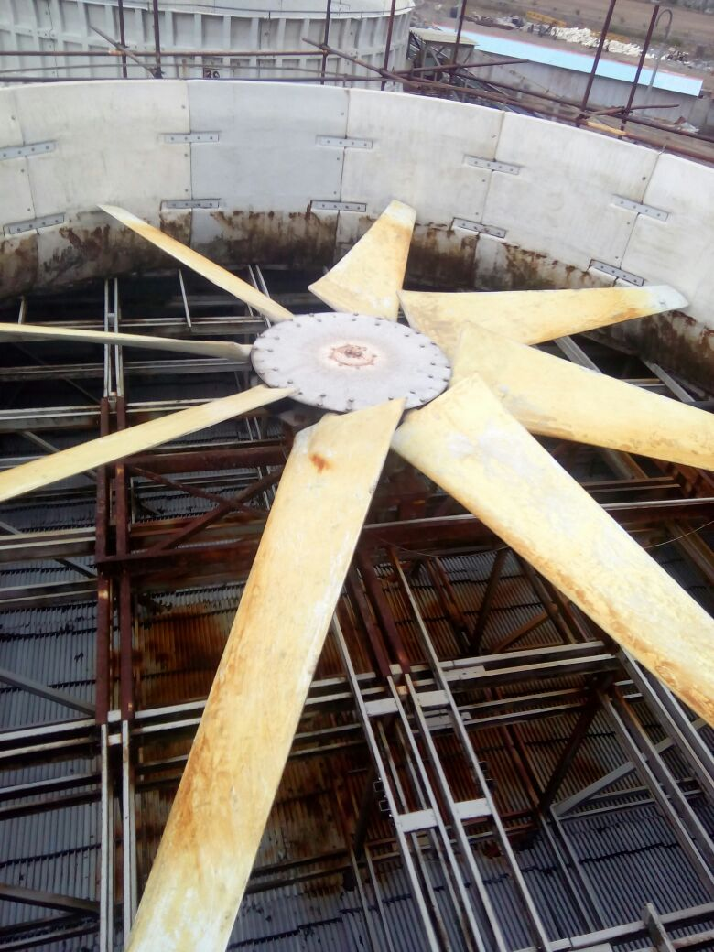
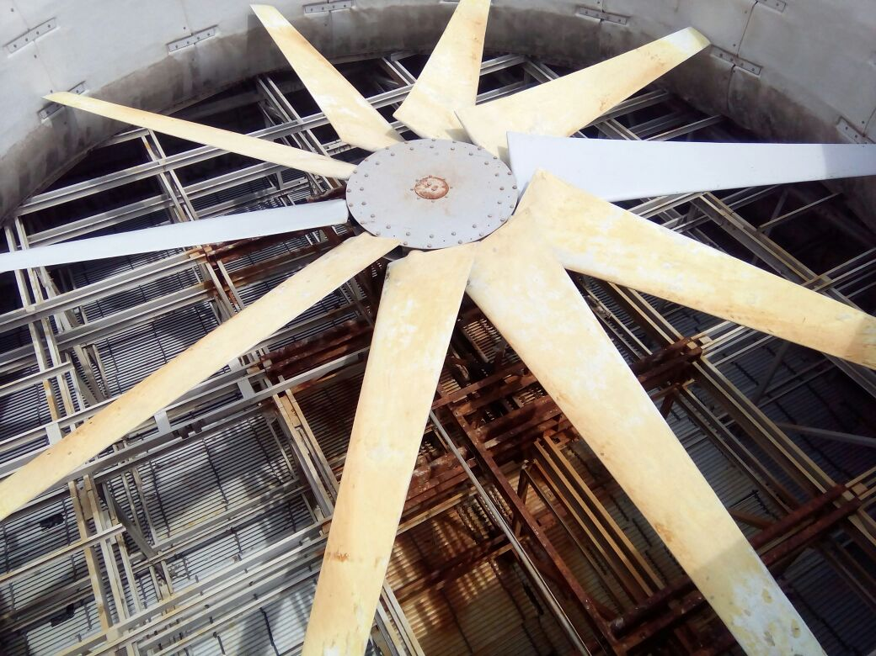
Changed Fan Configuration

Slide 27
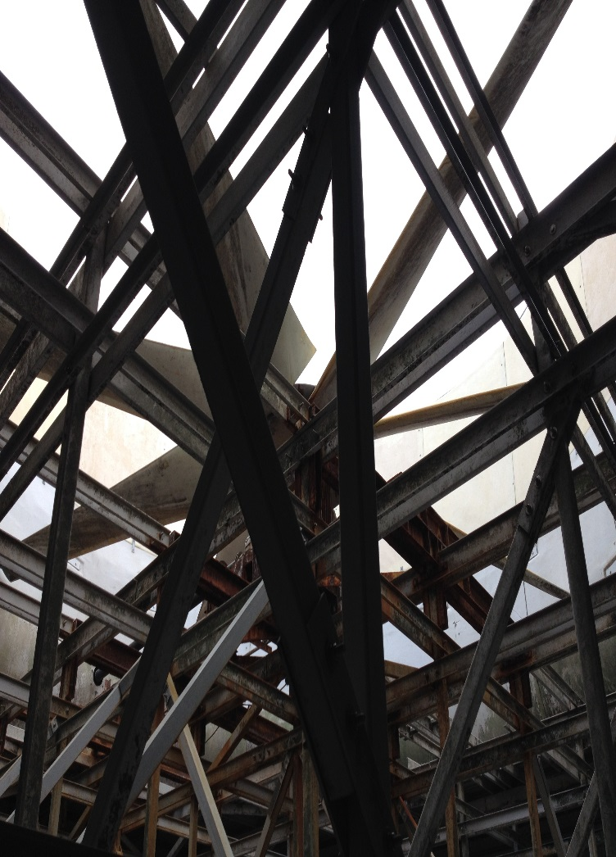
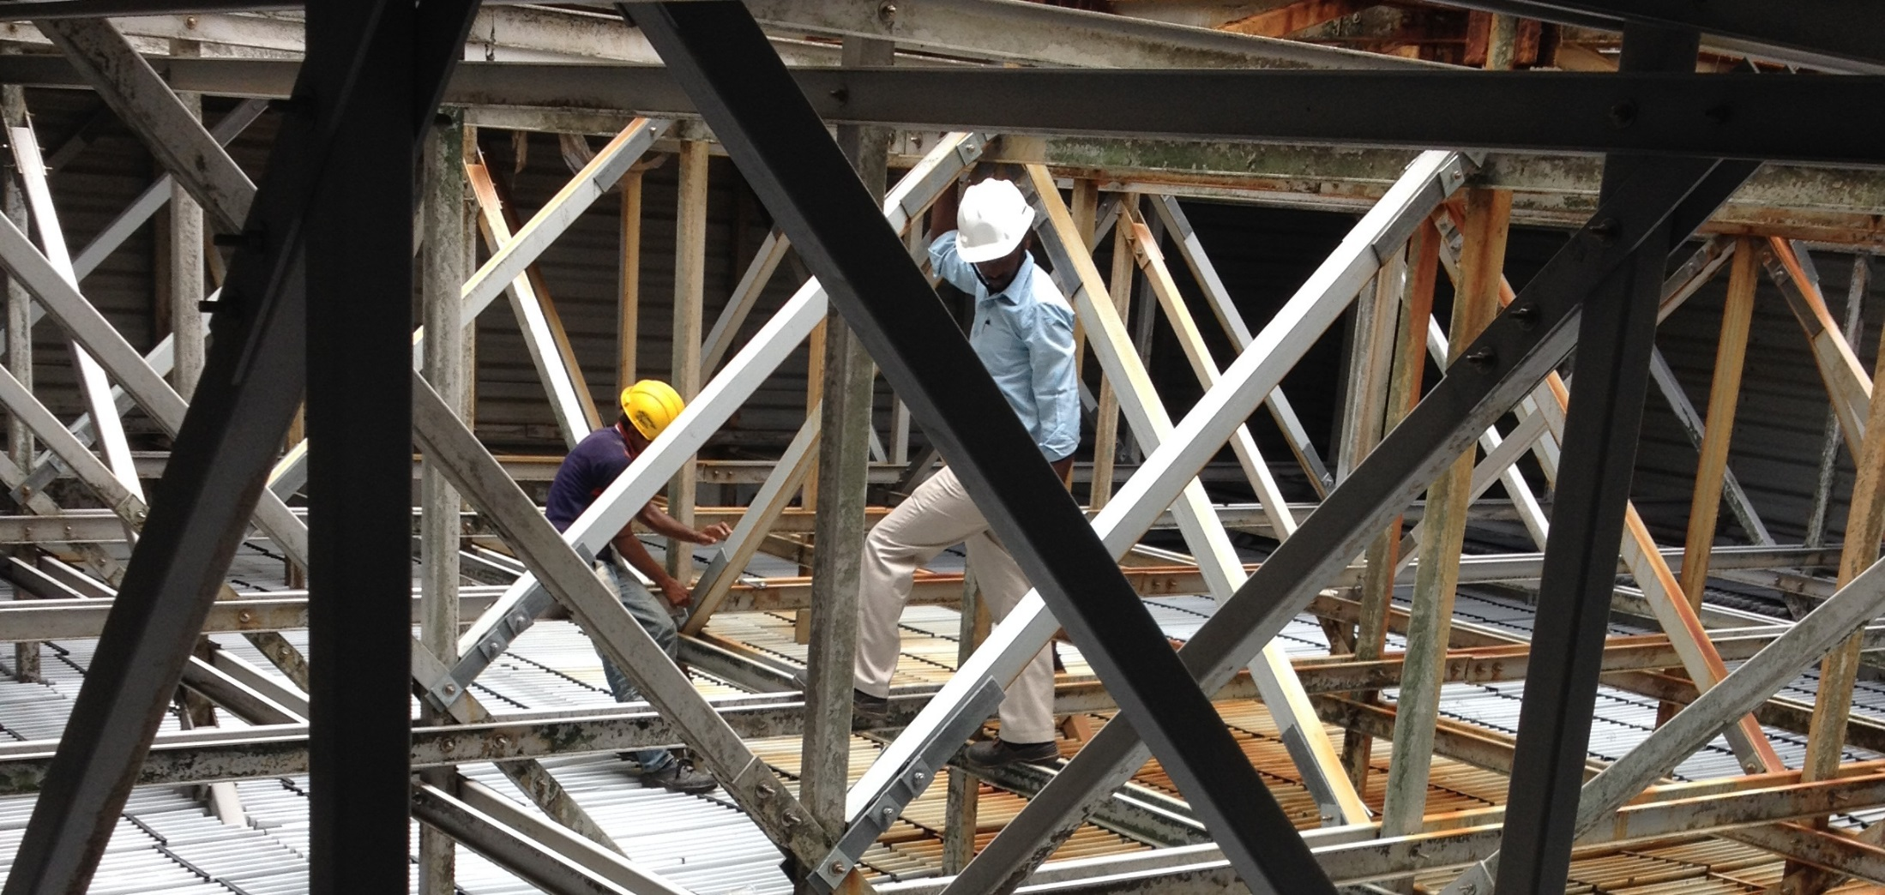
Improved Mechanical Support

Slide 28
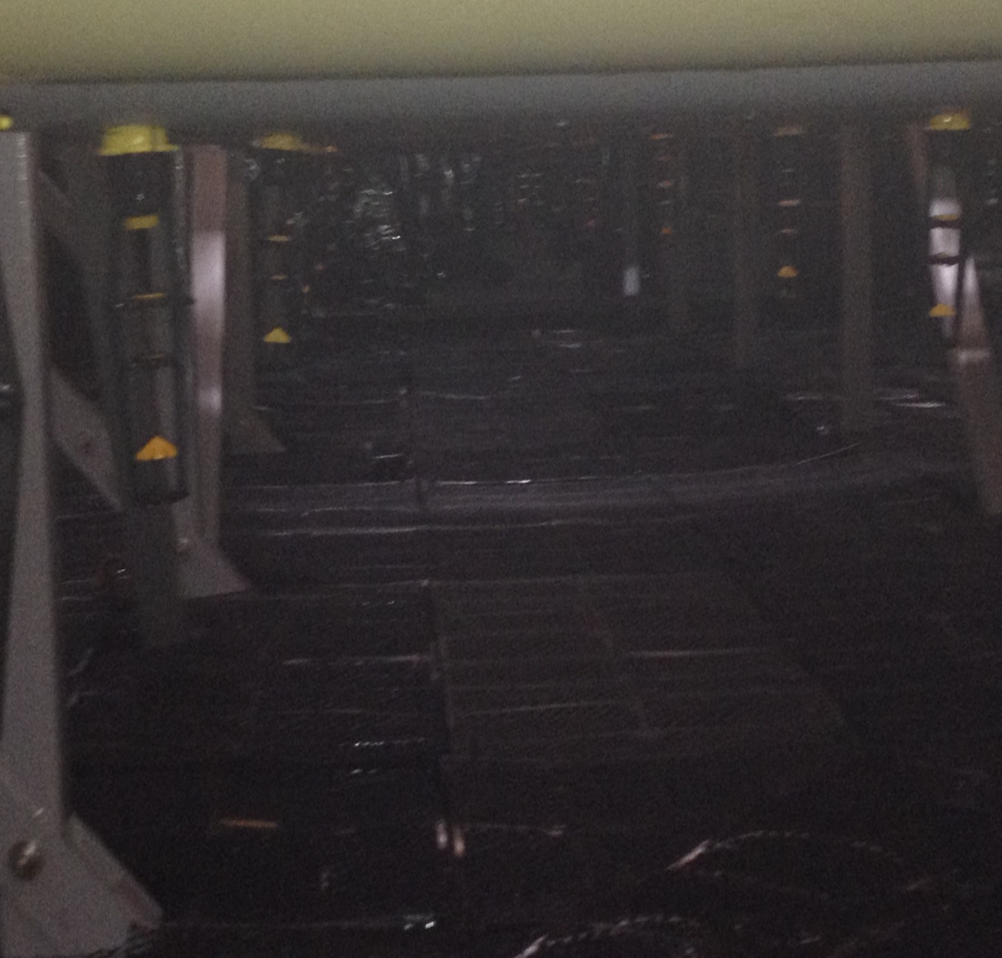
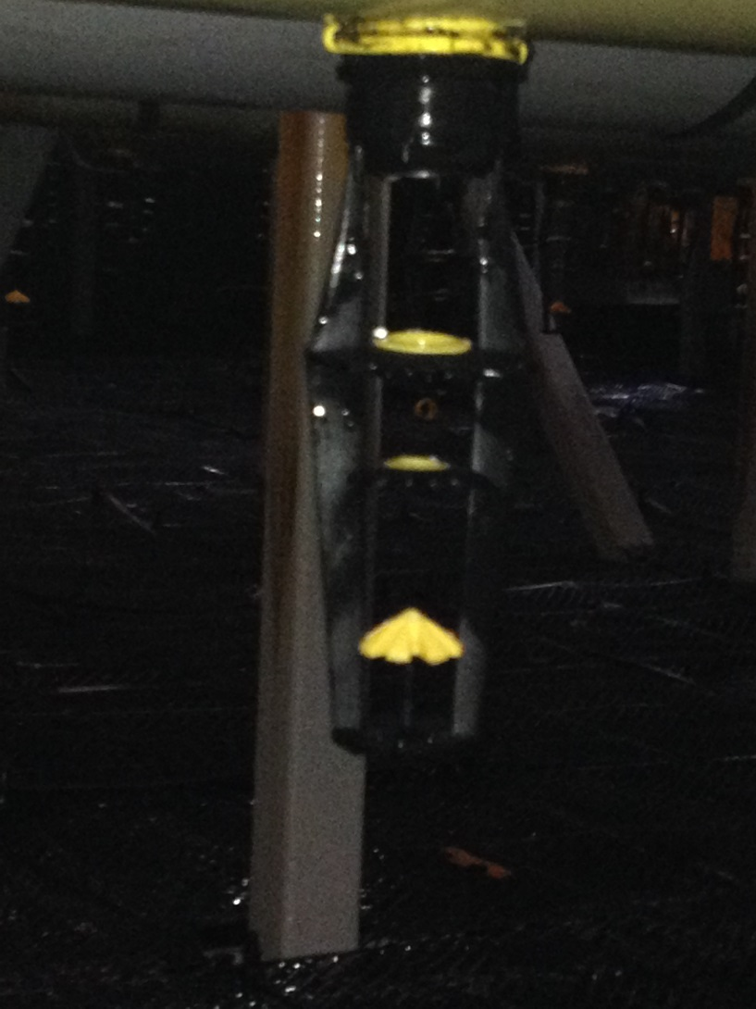
Aerotech Four Stage Nozzle

Slide 29
MODIFIED CT PERFORMANCE TEST REPORT

